Slide 1
IRONY
Irony defined with examples

Slide 2
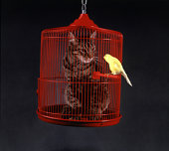
What is Irony?
Irony is about expectations.
Irony - The difference between what someone would reasonably expect to happen and what actually does
3 kinds of irony
Verbal
Dramatic
Situational

Slide 3
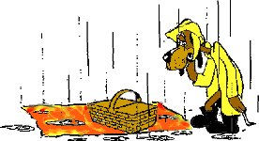
Verbal Irony
A contrast between what is said and what is actually meant
Sarcasm
Example: When it is a dark, gloomy, rainy, day and someone says, "Wow, what a gorgeous day!“
The locker room smells really good.
Awesome! Another homework packet!

Slide 4
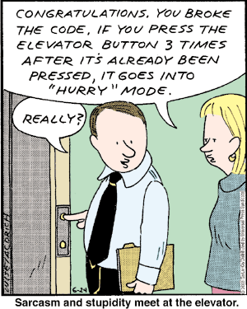
Verbal Irony

Slide 5
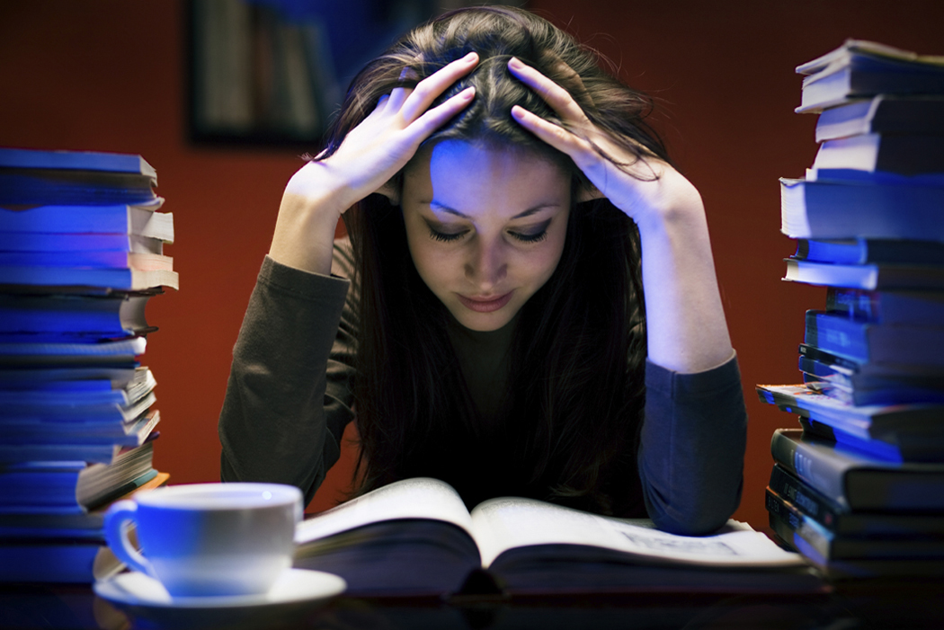
Situational Irony
When one's efforts produces the opposite results of what was expected
Example: When you have stayed up all night cramming for a test the next day, and the test is actually not until the next week.

Slide 6
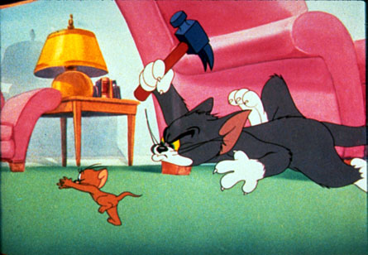
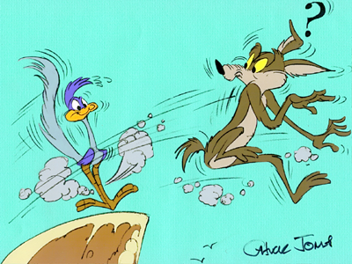
Situational Irony

Slide 7
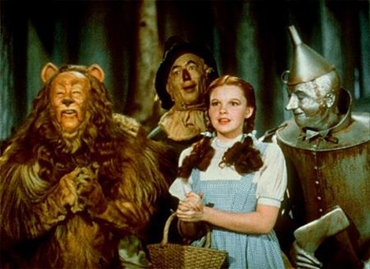
Situational Irony
The Scarecrow longs for intelligence, only to discover he is already a genius,
The Tin man longs to be capable of love, only to discover he already has a heart.
The Lion, who at first appears to be a whimpering coward turns out to be bold and fearless
The people in Emerald City believe the Wizard to have been a powerful deity, only to discover he was a bumbling eccentric old man.

Slide 8
or
General Sedgwick’s last words were, “They couldn’t hit an elephant at this distance.”
Bill Gates uses an Apple computer.

Slide 9
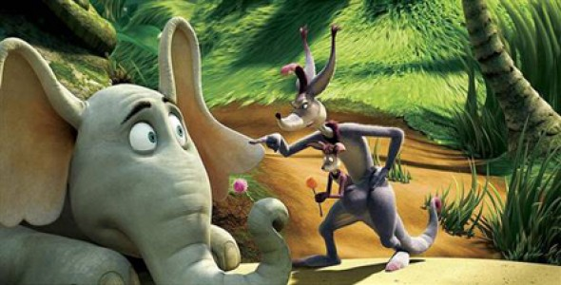
Dramatic Irony
When the audience knows things the characters do not
In Horton Hears a Who, we know that Horton really is talking to little people on a bubble, but everyone else thinks he's crazy.

Slide 10
or
Tim’s parents are proud of the “A” he got on the test, but we know he cheated.
Alex writes a love poem to Judy but we know that Judy loves Devin.

Slide 11
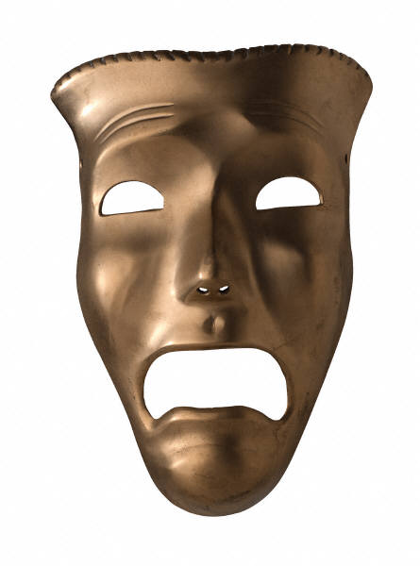
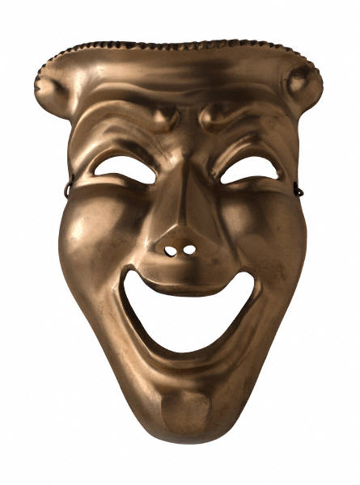
Dramatic Irony
On a TV talk show, a guest thinks she is there to have a makeover, but the audience knows that she will soon be confronted by her cheating husband and his girlfriend.

Slide 12
Review
Something that is ironic is unexpected.
If unexpected by a character, it’s dramatic.
If unexpected by everyone, it’s situational.
If it’s sarcasm, it’s verbal.

