Slide 1
PROPAGANDA
versus persuasion

Slide 2
What is propaganda
“Propaganda is the deliberate, systematic attempt to shape perceptions, manipulate thoughts, and direct behavior to achieve a response that furthers the desired intent of the propagandist.”
—Jowett & O'Donnell, Propaganda and Persuasion

Slide 3
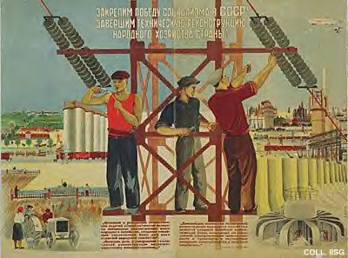
Government propaganda

Slide 4
Five characteristics of propaganda
Propaganda is in the eye of the beholder.
“I’m persuading. The other guy is using propaganda.”
Propaganda has a strong ideological intent.
example: PETA, Queer Nation, or the Army of God
Propaganda is institutional in nature. It is practiced by organized groups
governments, corporations, social movements, special interests
Propaganda relies on mass persuasion
television, radio, Internet, billboards
Propaganda tends to rely on ethically suspect methods of influence.
deception, distortion, misrepresentation, or suppression of information.

Slide 5
Common propaganda techniques
plain folks appeal (“I’m one of you”)
testimonials (“I saw the aliens, sure as I’m standing here”)
bandwagon effect (everybody’s doing it)
card-stacking (presenting only one side of the story)
transfer (positive or negative associations, such as guilt by association)
glittering generalities (idealistic or loaded language, such as “freedom” “empowering,” “family values”)
name calling (“racist,” “tree hugger,” “femi-nazi”)

Slide 6
plain folks appeal
Based on the “common man,” “person on the street” or the “little guy”
A politician calls himself a “populist” or “man of the people”
“In this time of change, government must take the side of working families.” (George Bush, address at the Republican National Convention, Sept. 3, 2004.

Slide 7
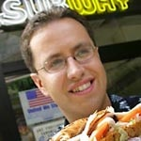
testimonials
Anecdotal evidence for diet pills, herbal remedies, new-age crystals, etc.
Anecdotal evidence of alien abductions, psychic phenomena
“I saw what looked to be a hairy human figure, about 6-6 1/2' tall, running behind my bike. Scared the crap out of me, so I hit the throttle and did what I could to get out of there.” (from the Bigfoot Field Researchers Organizations Website, report # 13424
Jarod Fogle for Subway

Slide 8
bandwagon effect
a “herd” mentality, following the crowd, or “counting heads”
An employee caught pilfering says, “everyone else does it.”
“A majority of Americans - 57% - say they believe in psychic phenomena such as ESP, telepathy or experiences that can’t be explained by normal means.” (CBS poll, April 28, 2002)

Slide 9
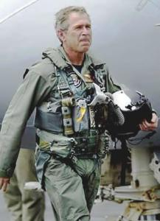
transfer
Projecting good or bad qualities from one person or group onto another
The positive or negative association will “rub off” on the other person or group
Politicians posing next to the flag, with troops, with veterans to appear patriotic
An ad for a dietary supplement features a researcher in a white lab coat with a clip board to make the product appear more scientific

Slide 10
glittering generalities
Using virtuous words; democracy, freedom, justice, patriotism, family values, motherhood, progress
Embracing values at a high level of abstraction
“change”
“green”
“reform”
“patriotism is always more than just loyalty to a place on a map or a certain kind of people. Instead, it is also loyalty to America’s ideals – ideals for which anyone can sacrifice, or defend, or give their last full measure of devotion.” Barack Obama, June 30, 2008

Slide 11
name calling
Ad hominem attacks
tree-hugging liberals, right-wing zealots, femi-nazis, bureaucrats
Barack Obama “palls around with terrorists.”
“Despite the hysterics of a few pseudo-scientists, there is no reason to believe in global warming” Rush Limbaugh, See I told You So (1993)

